Slide 1
Group - 8
File Transfer and Management System

Slide 2

Introduction
to the project
The project aims to create a file storage and management system using Linux (Ubuntu) and also utilises socket communication for the transfer of information using the help of C++ and system programming.

Slide 3

About the Project
The need for a FILE Transfer and management system
What is File Transfer?
File transfer refers to the exchange of data files between computer systems. According to Techopedia: “File transfer is the process of copying or moving a file from one computer to another over a network or internet connection. It enables sharing, transferring or transmitting a file or a logical data object between different users and/or computers both locally and remotely.”
01
Upload
02
Download
03
Display and Delete
The client has the functionality to upload files from their system onto the server
Files uploaded can be again retrieved back and downloaded by the client
Optionality to display the files is presented and also the ability to destroy and delete the files from the server.

Slide 4
What the project offers
Aims and objective of the project
01
02
03
04
Create a FILE system
Implement sockets
Add the functions
An interactive UI
FILE system created using a server and client model
Implement socket communication to allow the server and the client to communicate with each other.
Functionalities like upload(), download(), and display() are added to the project.
We also implemented an interactive UI to make the entire process seamless for the client

Slide 5

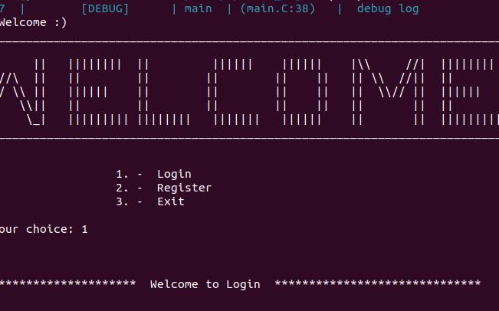
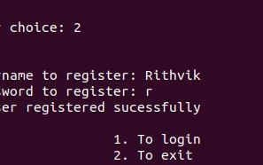
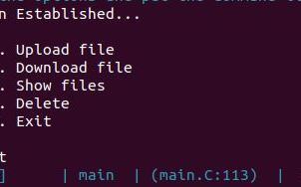

Code snippets
What We’ve Done
A sneak peek into the project and the UI and its UX

Slide 6



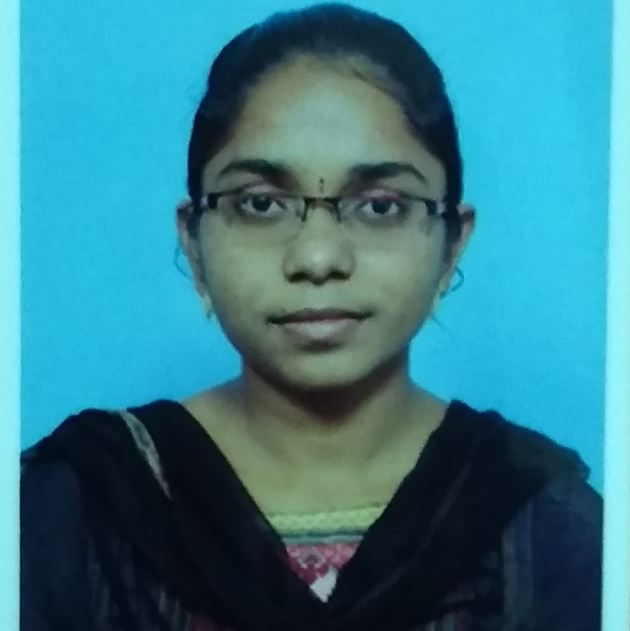
About Us
Sneak Peek into the members of the projects
Raja Babu
P Rajyalakshmi
Associate Consultant
Analyst
.
.
Rithvik G
Naveen G
Senior Analyst
Senior Analyst

Slide 7
Thank You
ppt created by G. Rithvik

